Slide 1
Transmission Rate Calibration method: Bayesian Approach
Sol Kim
2025.02.14 (Fri)

Slide 2
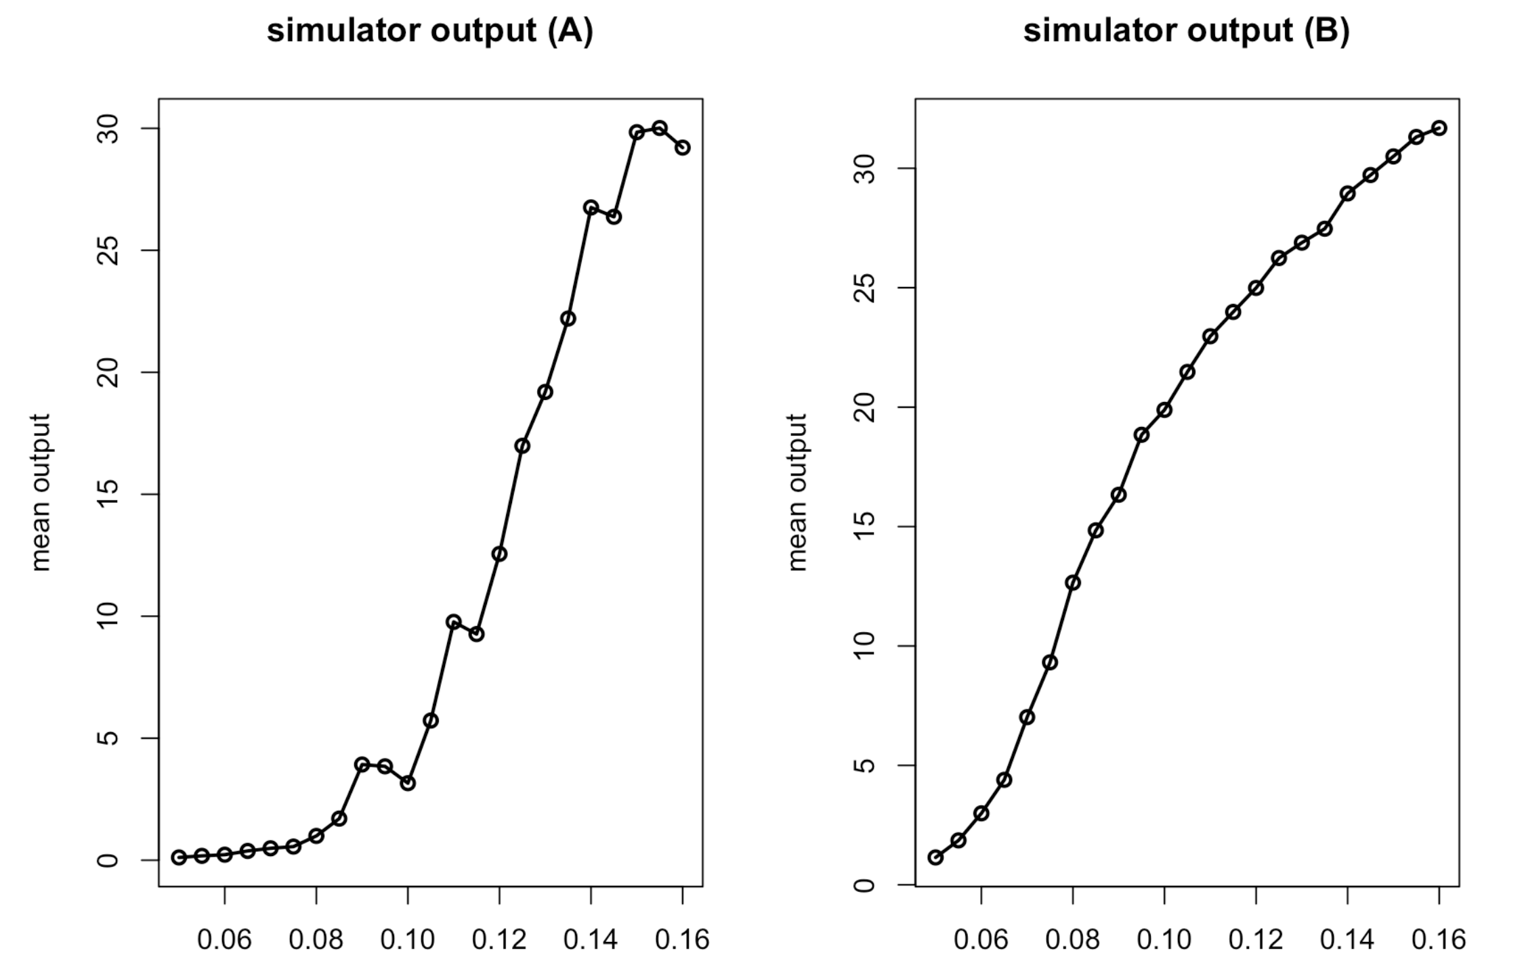
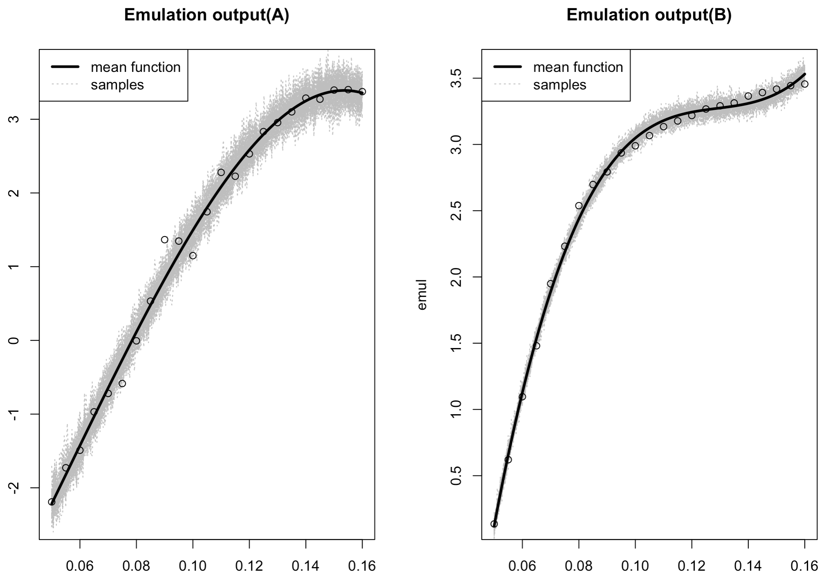



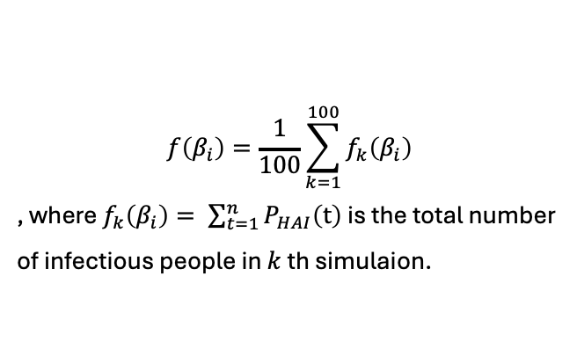

What is Simulation, Emulation?
Simulation (ABM)
Emulation
$$β_{i}$$
$$f\left(β_{i}\right)$$
$$β$$
$$f\left(β\right)$$
$$f\left(β_{i}\right)=\frac{1}{100}\sum_{k=1}^{100}{f_{k}\left(β_{i}\right)}$$
, where $f_{k}\left(β_{i}\right)= \sum_{t=1}^{n}{P_{HAI}\left(t\right)}$ is the total number of infectious people in $k$ th simulaion.

Slide 3


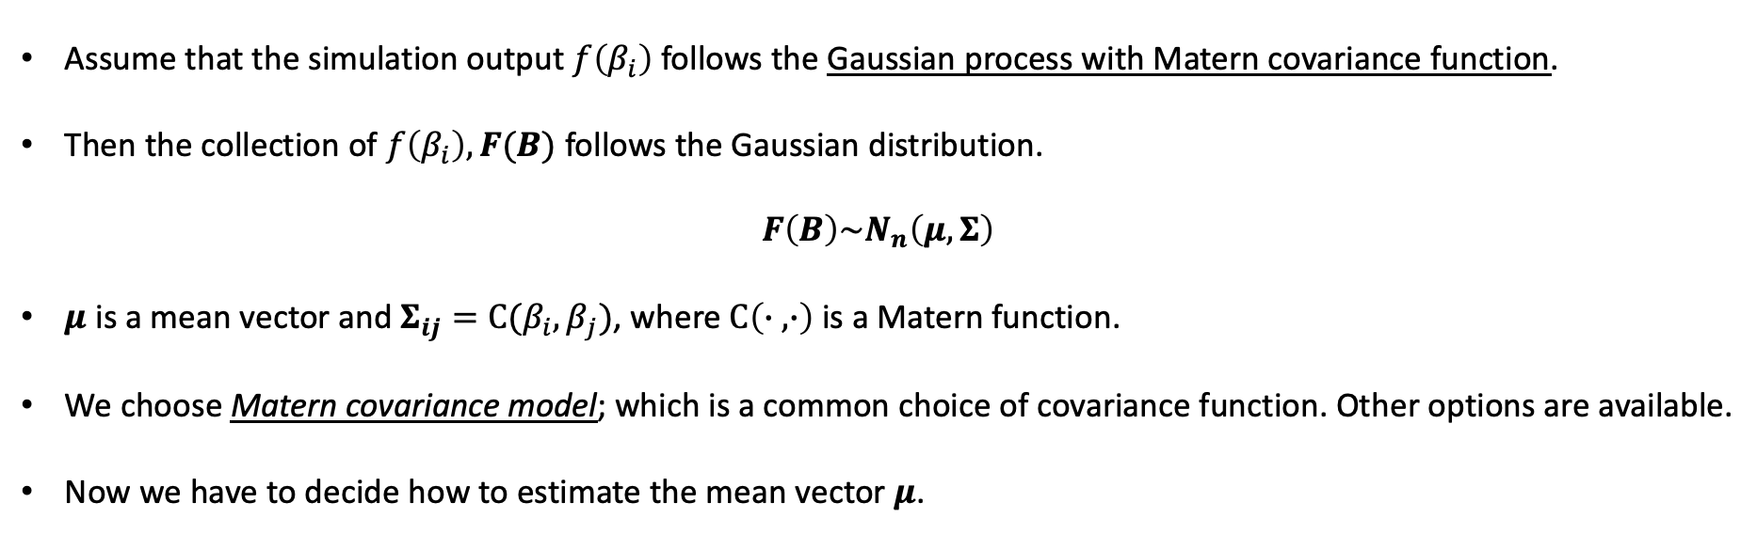




How do we get the emulation?
Simulation (ABM)
$$β_{i}$$
$$P_{HAI}\left(t\right)$$
$$f\left(β_{i}\right)$$
Emulation
$$β$$
$$log(f\left(β\right))$$
$$f\left(β\right)$$
Assume that the simulation output $f\left(β_{i}\right)$follows the Gaussian process with Matern covariance function.
Then the collection of $f\left(β_{i}\right), F(Β)$ follows the Gaussian distribution.
$$F\left(Β\right)\sim N_{n}\left(μ, Σ\right)$$
$μ$ is a mean vector and $Σ_{ij}=C(β_{i},β_{j})$, where $C\left(∙ ,∙\right)$ is a Matern function.
We choose Matern covariance model; which is a common choice of covariance function. Other options are available.
Now we have to decide how to estimate the mean vector $μ$.

Slide 4
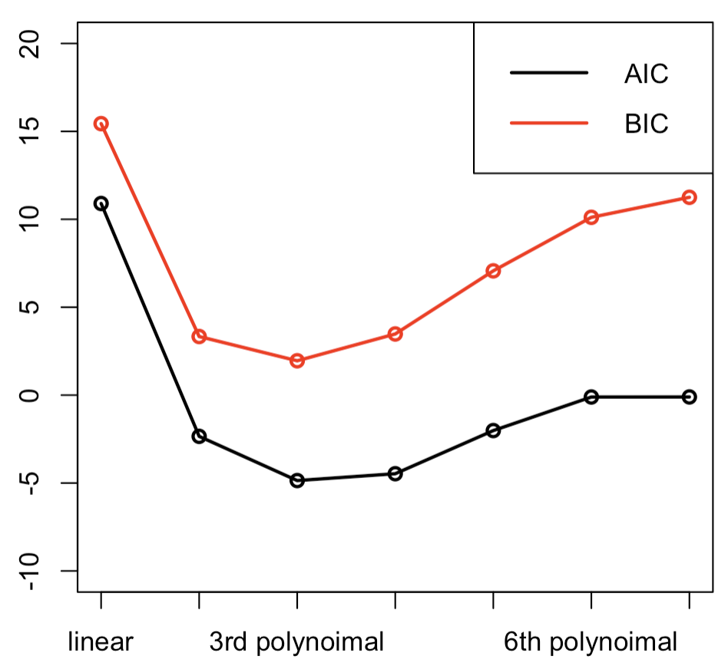
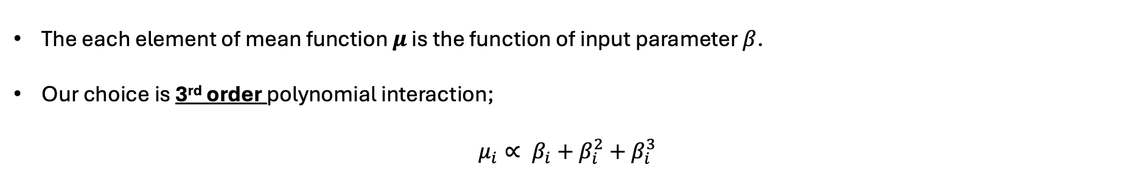
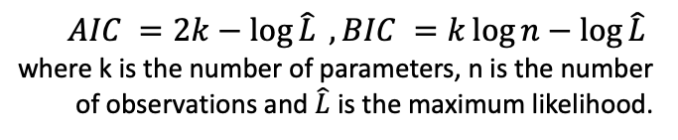
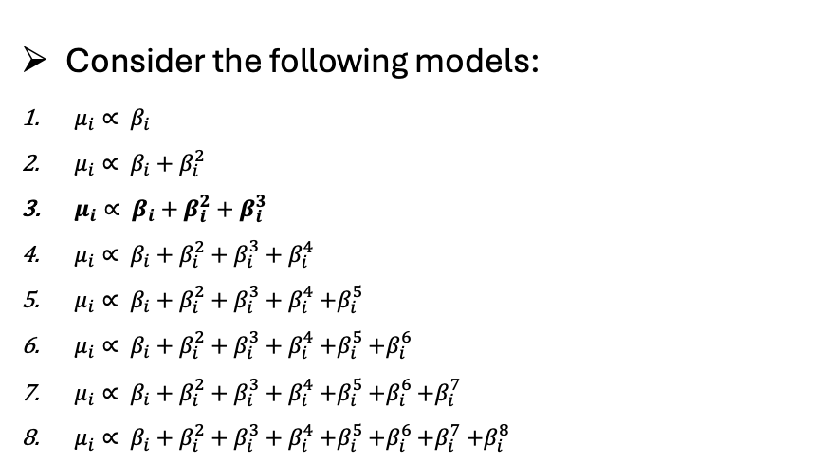
How do we get the emulation? (Cont’d)
The each element of mean function $μ$ is the function of input parameter $β$.
Our choice is 3rd order polynomial interaction;
$$μ_{i}∝ β_{i}+β_{i}^{2}+β_{i}^{3}$$
$AIC =2k−\log{\hat{L} }, BIC =k\log{n}−\log{\hat{L} }$
where k is the number of parameters, n is the number of observations and $\hat{L}$is the maximum likelihood.
Consider the following models:
$μ_{i}∝ β_{i}$
$μ_{i}∝ β_{i}+β_{i}^{2}$
$μ_{i}∝ β_{i}+β_{i}^{2}+β_{i}^{3}$
$μ_{i}∝ β_{i}+β_{i}^{2}+β_{i}^{3}+β_{i}^{4}$
$μ_{i}∝ β_{i}+β_{i}^{2}+β_{i}^{3}+β_{i}^{4}$ $+β_{i}^{5}$
$μ_{i}∝ β_{i}+β_{i}^{2}+β_{i}^{3}+β_{i}^{4}$ $+β_{i}^{5}$ $+β_{i}^{6}$
$μ_{i}∝ β_{i}+β_{i}^{2}+β_{i}^{3}+β_{i}^{4}$ $+β_{i}^{5}$ $+β_{i}^{6}$ $+β_{i}^{7}$
$μ_{i}∝ β_{i}+β_{i}^{2}+β_{i}^{3}+β_{i}^{4}$ $+β_{i}^{5}$ $+β_{i}^{6}$ $+β_{i}^{7}$ $+β_{i}^{8}$

Slide 5

How do we get the emulation? (Cont’d)
Fortunately, there are many packages for fitting the emulator.
We use the DiceKriging package to fit emulator.
## packages
library(DiceKriging);library(splines)
## Fit an emulator
fit.emul.a<-km(~x+I(x^2)+I(x^3), design=theta, response=response.a, covtype = “matern5_2”)
fit.emul.b<-km(~x+I(x^2)+I(x^3), design=theta, response=response.b, covtype = “matern5_2”)
## Visualize; Does it interpolate between the points well?
new.grid<-data.frame(x=seq(theta[1,1], theta[dim(theta)[1],1], length.out=200))
pred.emul.a<-predict.km(fit.emul.a, newdata = new.grid, "UK")
pred.emul.b<-predict.km(fit.emul.b, newdata = new.grid, "UK")
## Get samples (from normal distribution)
y=simulate(fit.emul.a, newdata=new.grid)
y=simulate(fit.emul.b, newdata=new.grid)
## Get mean function
y=pred.emul.a$trend
y=pred.emul.b$trend
$x axis: β$
$y axis : log⁡(f(β))$
Notes:
## y=pred.emul.a$trend << (sample의 가운데 찍히는)이게 내가 예상한 평균값
## y=pred.emul.b$trend

Slide 6

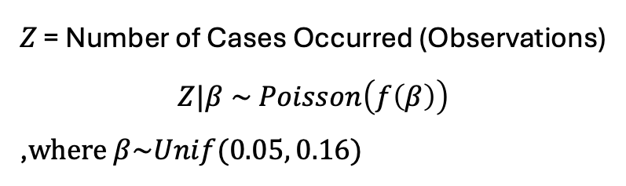
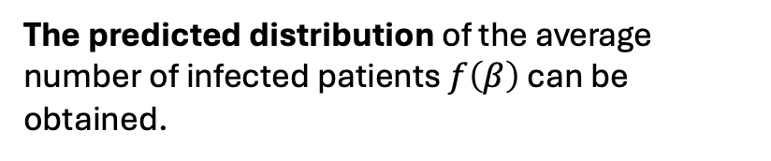
Why do we need the emulation? (Calibration Design)
Emulation
$$β$$
$f\left(β\right)$ : Prediction of the average number of infected patients
The predicted distribution of the average number of infected patients $f\left(β\right)$ can be obtained.
$Z$ = Number of Cases Occurred (Observations)
$$Z|β \sim Poisson\left(f\left(β\right)\right)$$
,$where β\sim Unif(0.05, 0.16)$

Slide 7
How to calibrate beta from the emulation
Metropolis-Hastings Algorithm: Detailed MCMC Implementation
n.iter <- 50000 # MCMC 반복 횟수 (샘플 개수)
init.beta <- 0.1 # β의 초기값 설정
step_size <- 0.01 # 새로운 β를 제안할 때 사용하는 표준편차
init.eta <- exp(simulate(fit.emul.a, newdata=data.frame(x=init.beta))) # 초기 η = f(β) 값
for(i in 2:n.iter){
## Create a new beta proposed as a normal distribution in the previous beta
prop <- rnorm(1,beta.sample2[i-1],sd=step_size)
if(prop<min(theta) | prop>max(theta)){ #reject
beta.sample2[i]<-beta.sample2[i-1]
eta.sample2[i]<-eta.sample2[i-1]
}
else{
eta_pr<-exp(simulate(fit.emul.b,newdata=data.frame(x=prop))) # 제안된 beta로 η 계산
ll_pr<-sum(dpois(obs.b, eta_pr, log=T)) # 새로운 η에 대한 log-likelihood 계산
ll_cu<-sum(dpois(obs.b, (eta.sample2[i-1]), log=T)) # 기존 η에 대한 log-likelihood 계산
acc<-ll_pr-ll_cu # 기존 η와 새로운 η에 대한 로그 확률비 계산
if(log(runif(1)) < acc){ #accept
beta.sample2[i]<-prop
eta.sample2[i]<-eta_pr
acc_rate2<-acc_rate2+1
}
else{
beta.sample2[i]<-beta.sample2[i-1]
eta.sample2[i]<-eta.sample2[i-1]
}
}
}

Slide 8
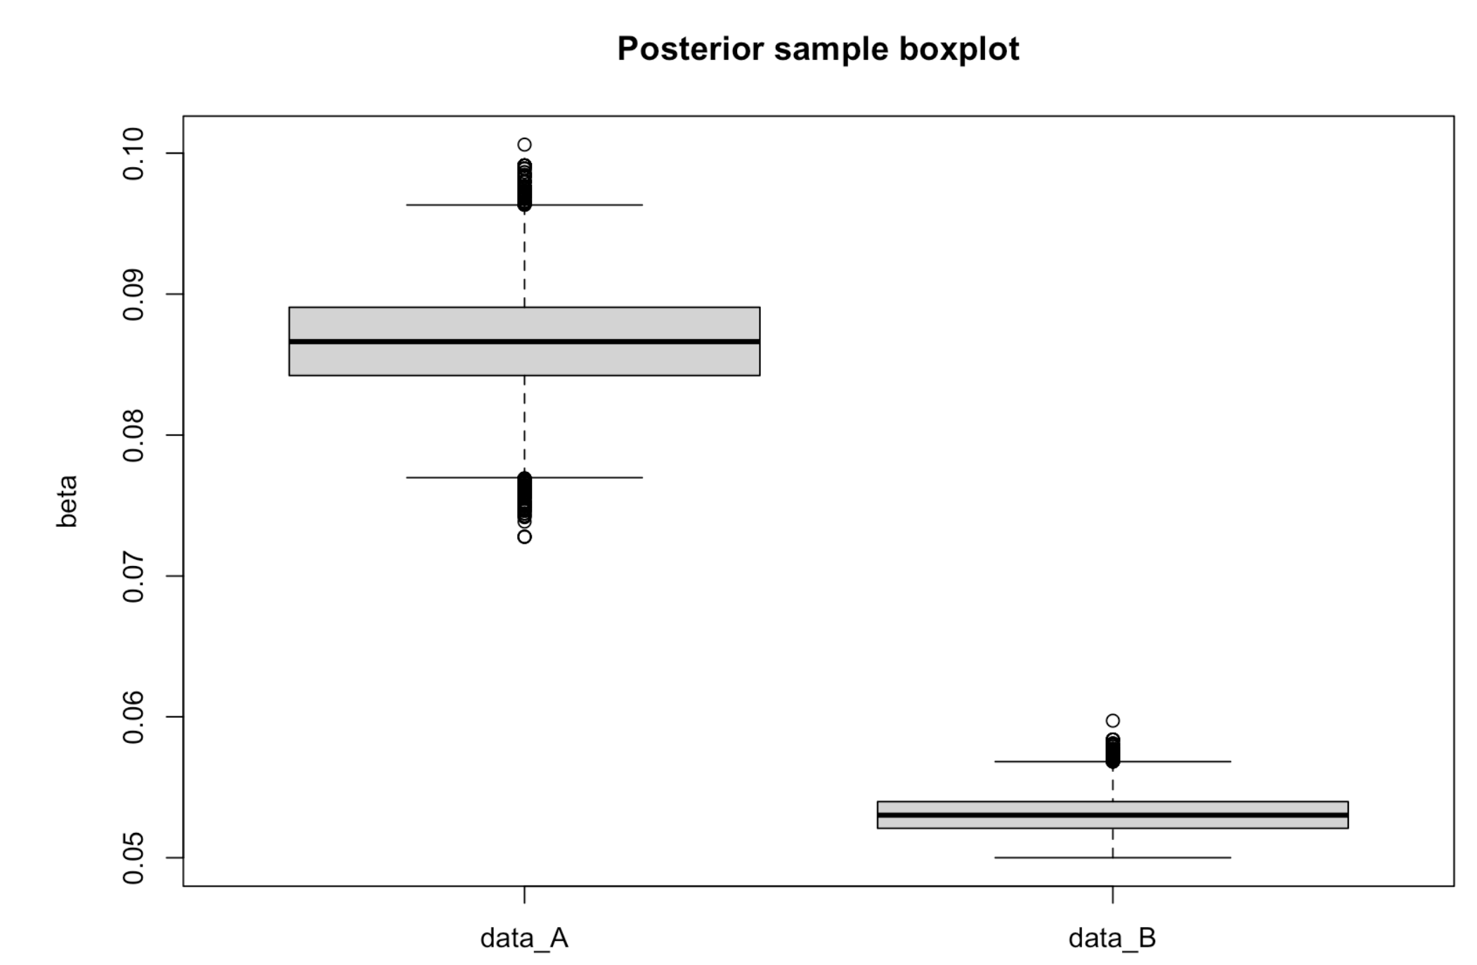
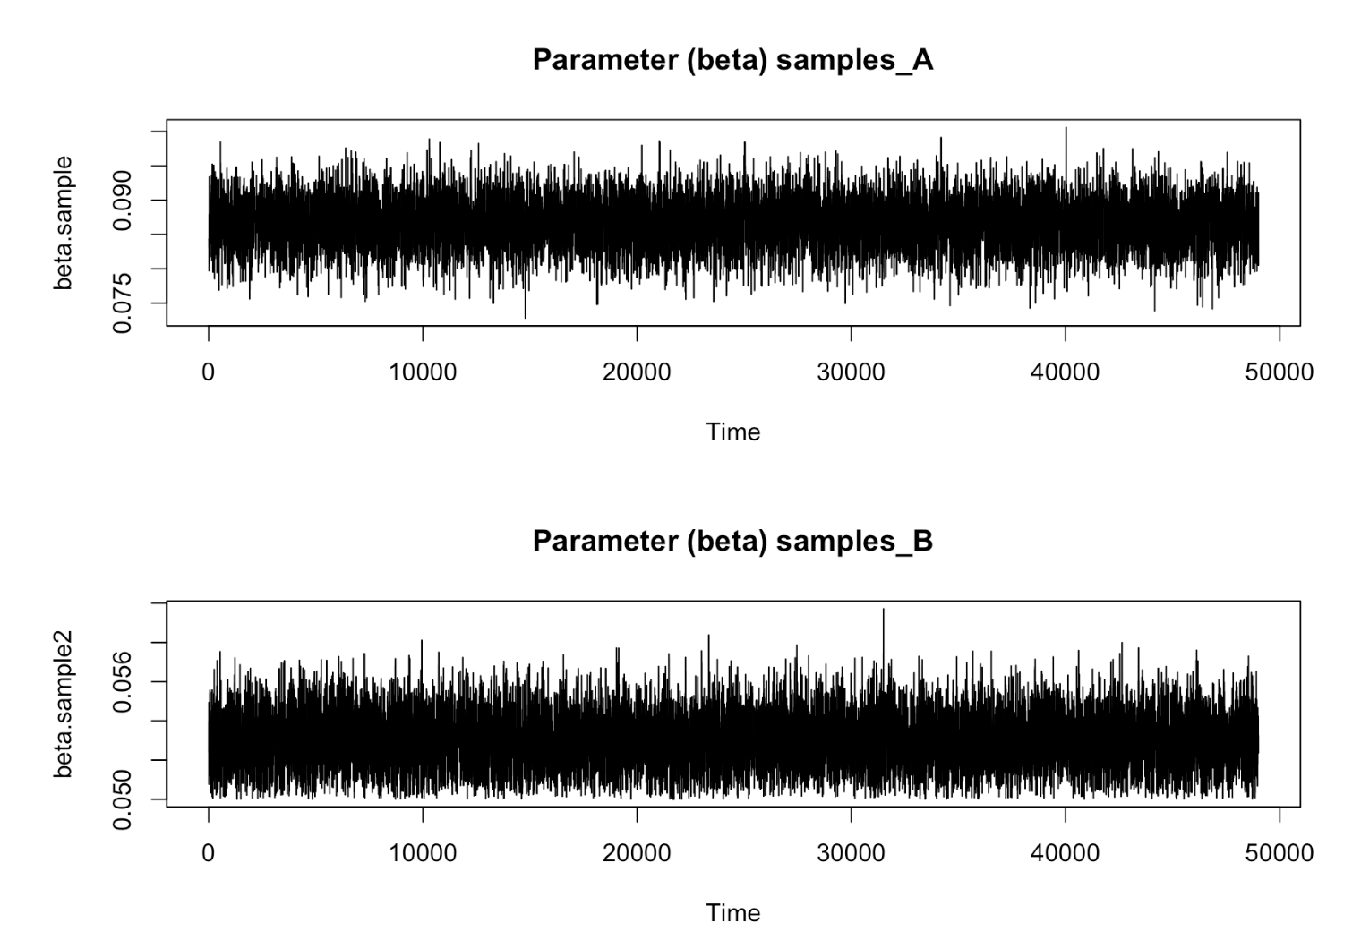
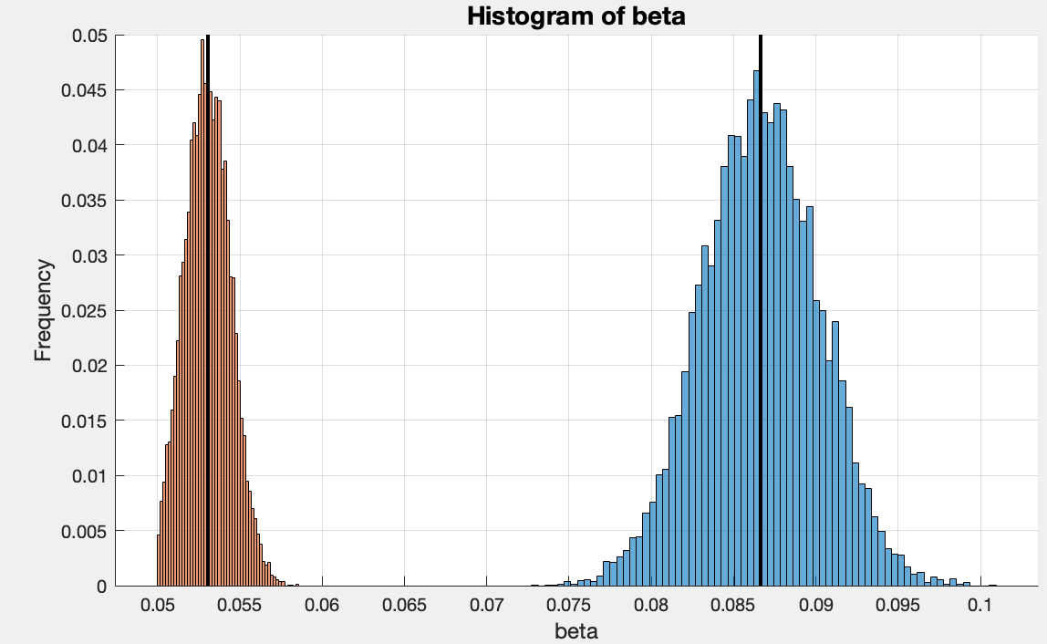
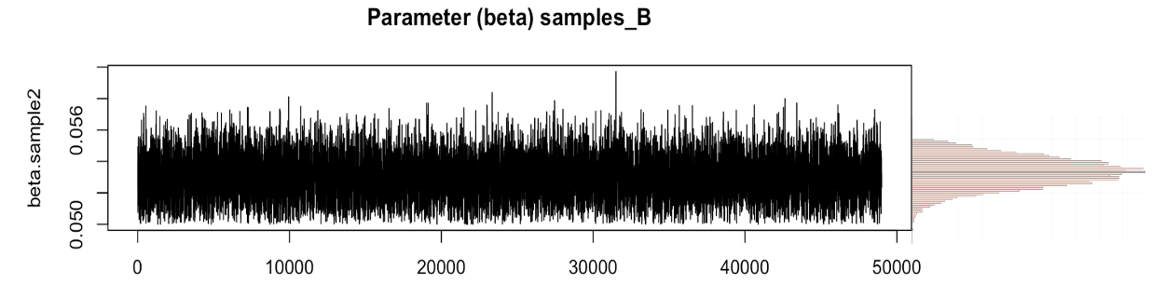
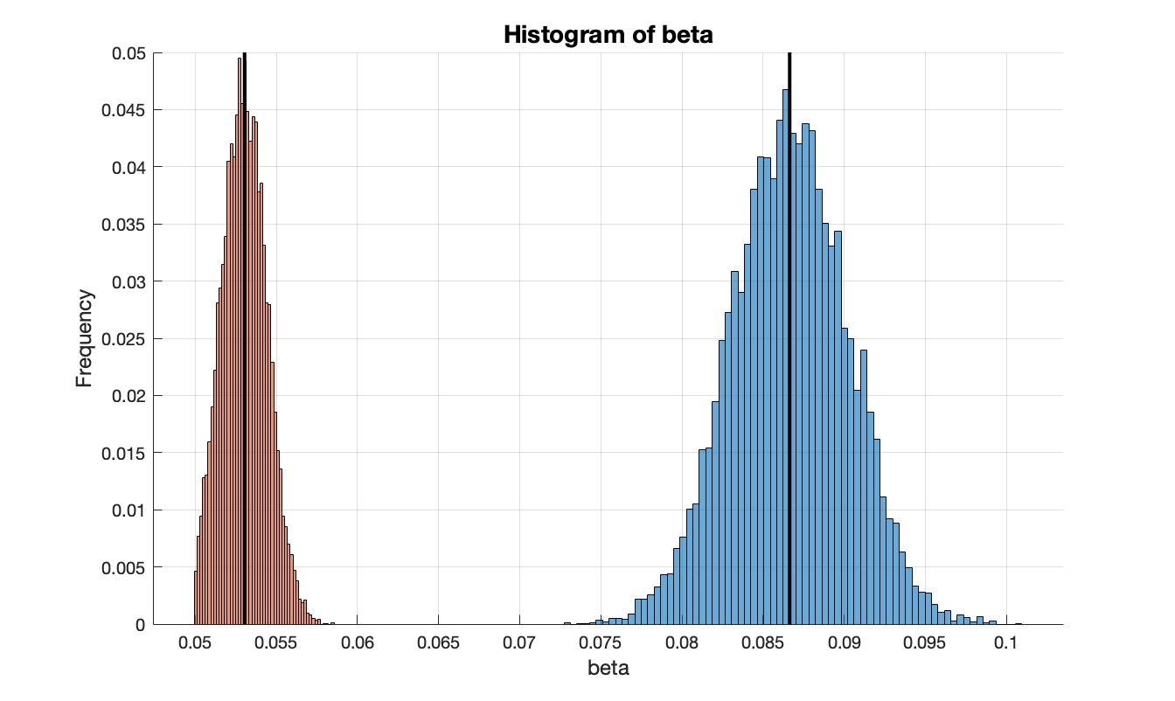


Results of Calibration
1. Box (Gray) – IQR (Middle 50%) : A has a larger box → More variability
2. Bold Line – Median (Q2) : Centered → Symmetric distribution
3. Whiskers (Solid Lines) : B’s whisker is longer on one side → Skewed distribution
4. Dots (Outliers) : A has more outliers → More extreme values
$$β_{B}$$
$$β_{A}$$
Notes:
Box plot 해석 방법
회색박스 : 데이터의 50%를 포함하는 사분위 범위 (IQR) → A가 박스가 더 크므로 변동성이 좀더 크다.
박스 안 굵은 선 : 중앙 값 Q2 – 한쪽으로 치우쳐지지 않았으므로 대칭분포형태를 띈다.
박스 밖 실선 : Whisker 최대, 최소 값 (이상 값 제외) Q3 + 1.5 X IQR , Q1 - 1.5 X IQR → B의 경우 수염이 한쪽으로 치우져 있으므로, 왜도 (Skewness) 가 있음
실선 밖 점 : Outliers 이상치, Whisker를 벗어난 데이터 포인트 → A의 이상치가 많다.

Slide 9
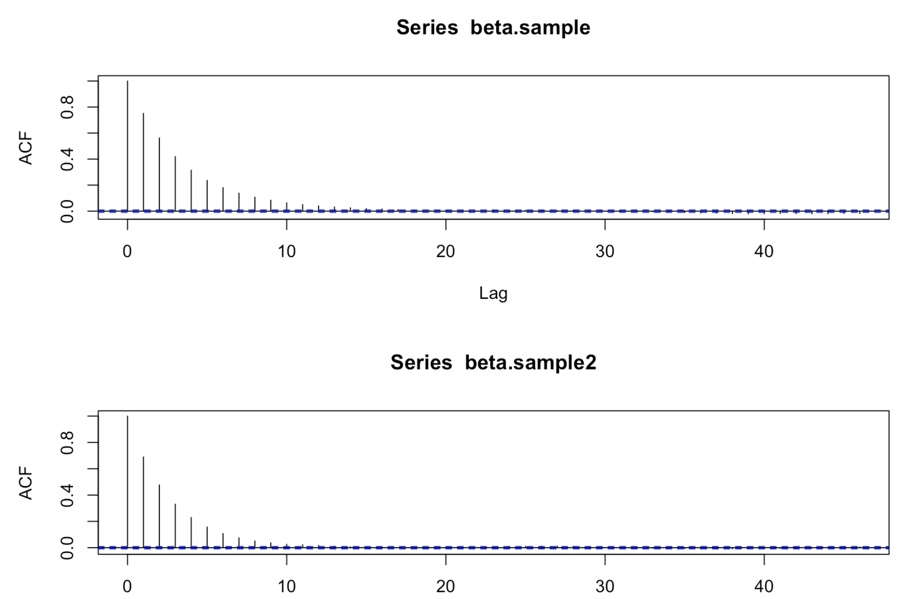
Results of Calibration (Cont’d)
Check if the estimation is accurate.
## ACF (Auto-Correlation Function) Analysis
acf(beta.sample)
acf(beta.sample2)
Measures the correlation between a value and its later values in the sequence.
Low autocorrelation indicates proper MCMC convergence.
Notes:
ACF : x 축 Lag --> 샘플횟수 사이의 거리
ex> Lag = 10
1번과 10번째 샘플 사이의 indepedence= ACF가 낮다.
1번과 10번재 샘플 사이의 dependence = ACF가 높다.
** 샘플 5만개 -> 후처리 initial value부터 움직이지만 앞부분 (bunr in)을 버리고 분석을 한다.
** 빨리 낮아져야 좋은 것 = 그것이 바로 직전값 에만 영향을 받고있다는 뜻.

